Slide 1
Module 2: Introduction to vSphere and the Software-Defined Data Center

Slide 2
Importance
As a vSphere administrator, you must be familiar with the components on which vSphere is based. You must also understand the following concepts:
Virtualization, the role of the ESXi hypervisor in virtualization and virtual machines
Fundamental vSphere components and the use of vSphere in the software-defined data center
Use of vSphere clients to administer and manage vSphere environments

Slide 3
Module Lessons
Overview of vSphere and Virtual Machines
vSphere Virtualization of Resources
vSphere User Interfaces
Overview of ESXi

Slide 4
Virtual Beans: Data Center
Virtual Beans has a data center at its company headquarters. The company's goals are as follows:
Use the latest version of vSphere.
Create a cost-effective, leading-edge data center.
Create a secure, scalable, high-performing, and highly available infrastructure.
Create a vSphere infrastructure that follows VMware best practices.
Open a second data center to serve as a backup site to the primary data center and to host new applications.
As a Virtual Beans administrator, you must decide how to implement these goals. But first, you must understand how a vSphere data center works.

Slide 5

Lesson 1: Overview of vSphere and Virtual Machines

Slide 6
Learner Objectives
After completing this lesson, you should be able to meet the following objectives:
Explain basic virtualization concepts
Describe how vSphere fits into the software-defined data center and the cloud infrastructure
Describe how to proactively manage your vSphere environment

Slide 7
Terminology (1)
Virtualization is associated with several key concepts, products, and features.
Term | Definition | Examples
Operating system | Software designed to allocate physical resources to applications | Microsoft Windows, Linux
Application | Software that runs on an operating system, consuming physical resources | Microsoft Office, Chrome
Virtual machine | Specialized application that abstracts hardware resources into software
Guest | The operating system that runs in a VM (also called the guest operating system) | Microsoft Windows, Linux
Hypervisor | Specialized operating system designed to run VMs | ESXi, Workstation, Fusion
Host | Physical computer that provides resources to the ESXi hypervisor

Slide 8
Terminology (2)
Term | Definition
vSphere | Server virtualization product of VMware that combines the ESXi hypervisor and the vCenter Server management platform
Cluster | Group of ESXi hosts whose resources are shared by VMs
vSphere vMotion | Feature that supports the migration of powered-on VMs from host to host without service interruption
vSphere HA | Cluster feature that protects against host hardware failures by restarting VMs on hosts that are running normally
vSphere DRS | Cluster feature that uses vSphere vMotion to place VMs on hosts and ensure that each VM receives the resources that it needs

Slide 9
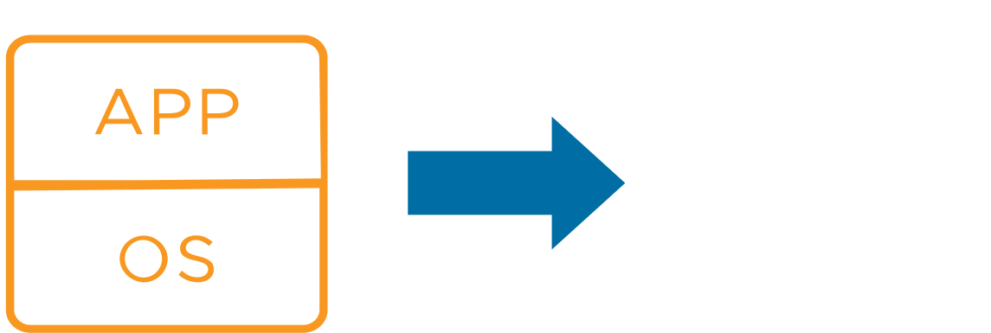
About Virtual Machines
A virtual machine (VM) is a software representation of a physical computer and its components. The virtualization software converts the physical machine and its components into files.
Virtual Machine Components
Guest operating system
VMware Tools
Virtual resources, such as:
CPU and memory
Network adapters
Disks and controllers
Parallel and serial ports
Notes:
A virtual machine (VM) includes a set of specification and configuration files and is supported by the physical resources of a host. Every VM has virtual devices that provide the same functionality as physical hardware but are more portable, more secure, and easier to manage.
VMs typically include an operating system, applications, VMware Tools, and both virtual resources and hardware that you manage in much the same way as you manage a physical computer.
VMware Tools is a bundle of drivers. Using these drivers, the guest operating system can interact efficiently with the guest hardware. VMware Tools adds extra functionality so that ESXi can better manage the VM's use of physical hardware.

Slide 10
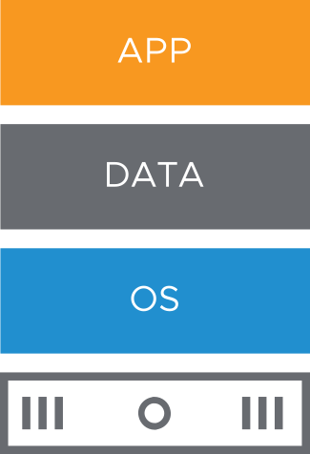
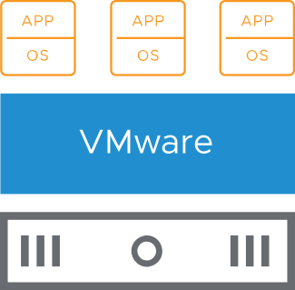
Benefits of Using Virtual Machines
Physical machines:
Difficult to move or copy
Bound to a specific set of hardware components
Often have a short life cycle
Require personal contact to upgrade hardware
Virtual machines:
Easy to move or copy
Independent of physical hardware because VMs are encapsulated into files
Isolated from other VMs running on same physical hardware
Insulated from physical hardware changes
Notes:
In a physical machine, the operating system (for example, Windows or Linux) is installed directly on the hardware. The operating system requires specific device drivers to support specific hardware. If the computer is upgraded with new hardware, new device drivers are required.
If applications interface directly with hardware drivers, an upgrade to the hardware, drivers, or both can have significant repercussions if incompatibilities exist. Because of these potential repercussions, hands-on technical support personnel must test hardware upgrades against a wide variety of application suites and operating systems. Such testing costs time and money.
Virtualizing these systems saves on such costs because VMs are 100 percent software.
Multiple VMs are isolated from one another. You can have a database server and an email server running on the same physical computer. The isolation between the VMs means that software-dependency conflicts are not a problem. Even users with system administrator privileges on a VM’s guest operating system cannot breach this layer of isolation to access another VM. These users must explicitly be granted access by the ESXi system administrator. As a result of VM isolation, if a guest operating system running in a VM fails, other VMs on the same host are unaffected and continue to run.
A guest operating system failure does not affect access and performance:
Users can still access the other VMs.
The operational VMs can access the resources that they need.
The other VMs can still perform.
With VMs, you can consolidate your physical servers and make more efficient use of your hardware. Because a VM is a set of files, features that are not available or not as efficient on physical architectures are available to you, for example:
You can rapidly and consistently provision VMs.
With VMs, you can use live migration, fault tolerance, high availability, and disaster recovery scenarios to increase uptime and reduce recovery time from failures.
You can use multitenancy to mix VMs into specialized configurations, such as a DMZ.
With VMs, you can support legacy applications and operating systems on newer hardware when maintenance contracts on the existing hardware expire.

Slide 11
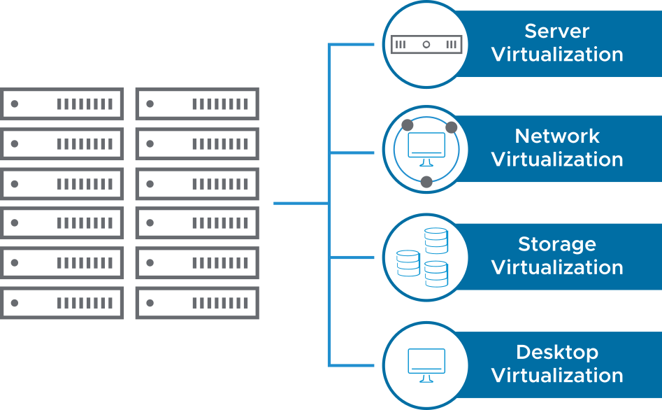
Types of Virtualization
Virtualization is the process of creating a software-based representation of something physical, such as a server, desktop, network, or storage device.
Virtualization is the single most effective way to reduce IT expenses while boosting efficiency and agility for all business sizes.
Notes:
Server virtualization addresses inefficiencies by allowing multiple operating systems to run on a single physical server as VMs, each with access to the underlying server’s computing resources.
Network virtualization is the complete reproduction of a physical network in software. Applications run on the virtual network exactly as if on a physical network.
Storage virtualization is the process of creating a software-based representation of network storage devices into what appears to be a single unit.
By deploying desktops as a managed service, you can respond more quickly to changing needs and opportunities.

Slide 12
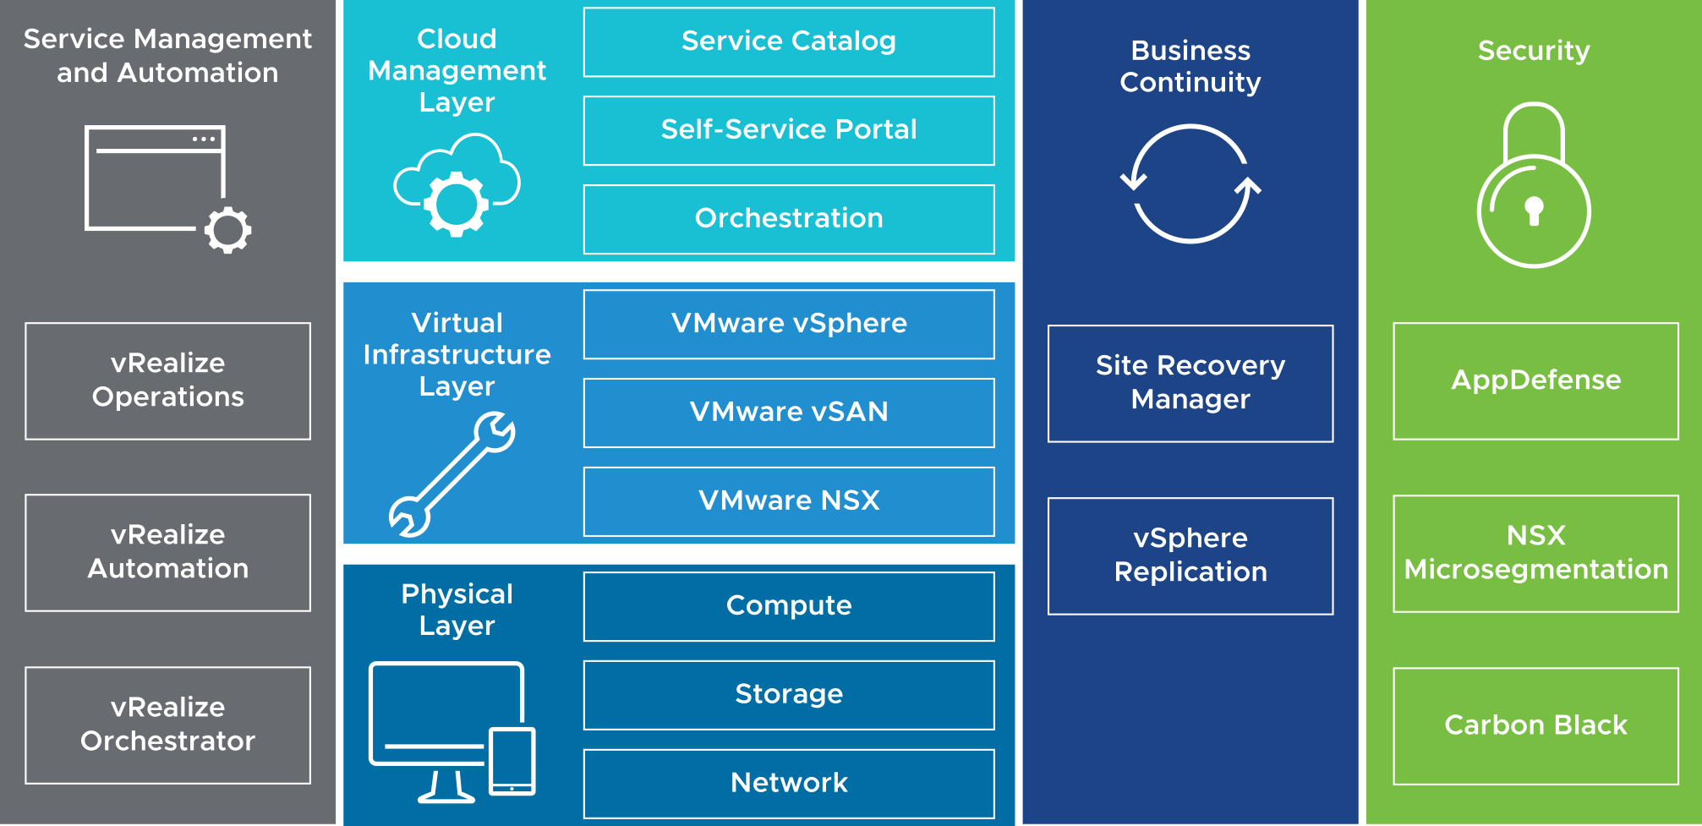
About the Software-Defined Data Center
In a software-defined data center (SDDC), all infrastructure is virtualized, and the control of the data center is automated by software. vSphere is the foundation of the SDDC.
Notes:
A software-defined virtual data center (SDDC) is deployed with isolated computing, storage, networking, and security resources that are faster than the traditional, hardware-based data center.
All the resources (CPU, memory, disk, and network) of a software-defined data center are abstracted into files. This abstraction brings the benefits of virtualization at all levels of the infrastructure, independent of the physical infrastructure.
An SDDC can include the following components:
Service management and automation: Use service management and automation to track and analyze the operation of multiple data sources in the multiregion SDDC. Deploy vRealize Operations Manager and vRealize Log Insight across multiple nodes for continued availability and increased log ingestion rates.
Cloud management layer: This layer includes the service catalog, which houses the facilities to be deployed. The cloud management layer also includes orchestration, which provides the workflows to deploy catalog items, and the self-service portal for end users to access and use the SDDC.
Virtual infrastructure layer: This layer establishes a robust virtualized environment that all other solutions integrate with. The virtual infrastructure layer includes the virtualization platform for the hypervisor, pools of resources, and virtualization control. Additional processes and technologies build on the infrastructure to support Infrastructure as a Service (IaaS) and Platform as a Service (PaaS).
Physical layer: The lowest layer of the solution includes compute, storage, and network components.
Security: Customers use this layer of the platform to meet demanding compliance requirements for virtualized workloads and to manage business risk.

Slide 13
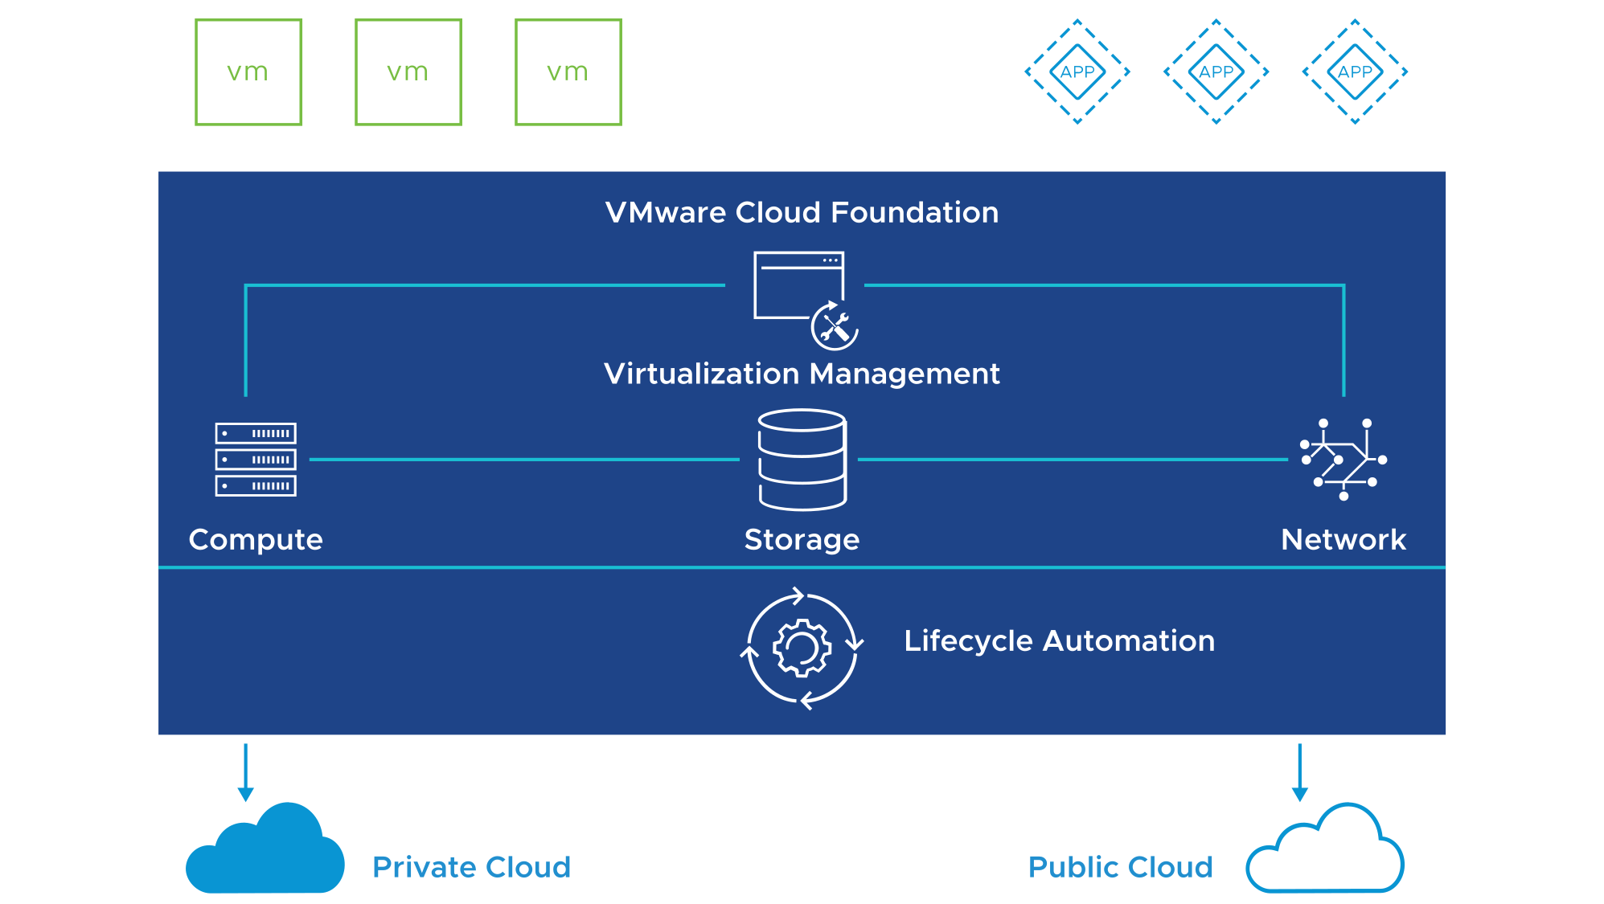
vSphere and Cloud Computing
Cloud computing exploits the efficient pooling of an on-demand, self-managed, and virtual infrastructure.
Notes:
As defined by the National Institute of Standards and Technology (NIST), cloud computing is a model for the ubiquitous, convenient, and on-demand network access to a shared pool of configurable computing resources. For example, networks, servers, storage, applications, and services can be rapidly provisioned and released with minimal management effort or little service provider interaction. vSphere is the foundation for the technology that supports shared and configurable resource pools. vSphere abstracts the physical resources of the data center to separate the workload from the physical hardware. A software user interface can provide the framework for managing and maintaining this abstraction and allocation.
VMware Cloud Foundation is the unified SDDC platform that bundles vSphere (ESXi and vCenter Server), vSAN, and NSX into a natively integrated stack to deliver enterprise-ready cloud infrastructure. VMware Cloud Foundation discovers the hardware, installs the VMware stack (ESXi, vCenter Server, vSAN, and NSX), manages updates, and performs lifecycle management. VMware Cloud Foundation can be self-deployed on compatible hardware or preloaded by partners and can be used in both private and public clouds (VMware Cloud on AWS or VMware cloud providers).
Use cases:
Cloud infrastructure: Exploit the high performance, availability, and scalability of the SDDC to run mission-critical applications such as databases, web applications, and virtual desktop infrastructure (VDI).
IT automation: Automate infrastructure and application delivery with self-service capabilities.
VDI: Provide a complete solution for VDI deployment at scale. It simplifies the planning and design with standardized and tested solutions fully optimized for VDI workloads.
Hybrid cloud: Build a hybrid cloud with a common infrastructure and a consistent operational model, connecting your on-premises and off-premises data center that is compatible, stretched, and distributed.
To find out more about VMware cloud computing, go to http://www.vmware.com/cloud-computing/overview.html.

Slide 14
About VMware Skyline
VMware Skyline is a proactive support technology that provides predictive analysis and proactive recommendations to help you avoid problems. VMware Skyline provides the following benefits:
Issue avoidance:
Proactively identifies potential issues based on environment-specific configuration, details, and usage.
Resolves issues before they occur, improving environment reliability and stability.
Shortens time to resolution:
Environment-specific, data-driven analytics accelerate problem resolution.
Personalized recommendations:
Resolution is specific to your environment.
No additional cost:
You receive additional value with your current support subscription (Basic, Production, or Premier support).
Notes:
VMware Skyline shortens the time it takes to resolve a problem so that you can get back to business quickly. VMware Technical Support engineers can use VMware Skyline to view your environment's configuration and the specific, data-driven analytics to help speed up problem resolution.

Slide 15
VMware Skyline Family
The VMware Skyline family includes Skyline Health and Skyline Advisor.
Skyline Health
All VMware Customers
Key capabilities: vSphere and vSAN findings Available in the vSphere Client Supports vSphere 6.7 U1 and later
Skyline Advisor
Production and Premier Support Customers
Key capabilities: Supports vSphere, vSAN, NSX for vSphere, vRealize Operations Manager, and VMware Horizon Supports vSphere 5.5 and later Tags VMware Validated Design, VxRail, and VMware Cloud Foundation deployments Automates log transfers with Log Assist Uses cloud-based ID and access
Premier Support Customers
Key capabilities: Advanced findings and reporting Tailored remediation plans
Notes:
With Basic Support, you can access Skyline findings and recommendations for vSphere and vSAN by using Skyline Health in the vSphere Client (version 6.7 and later).
With Production or Premier Support, you must use Skyline Advisor and the full functionality of Skyline (including Log Assist).
With Premier Support, you receive additional Skyline features that are not available with Production Support, for example:
An advanced set of proactive findings and recommendations
Scheduled and custom operational summary reports that provide an overview of the proactive findings and recommendations
All additional benefits of Premier Support, including the following services:
Designated support team
Direct access to senior-level technical support engineers
Assistance with multivendor troubleshooting
Onsite support services, such as Mission Critical Support (MCS), Healthcare Critical Support (HCS), and Carrier Grade Support (CGS)
Skyline supports vSphere, NSX for vSphere, vSAN, VMware Horizon, and vRealize Operations Manager. A Skyline management pack for vRealize Operations Manager is also available. If you install this management pack, you can see Skyline proactive findings and recommendations within the vRealize Operations Manager client.
The identification and tagging of VxRail and VMware Validated Design deployments help you and VMware Technical Support to better understand and support multiproduct solutions.
Skyline identifies all ESXi 5.5 objects within a vCenter Server instance and provides additional information in VMware knowledge base article 51491 at https://kb.vmware.com/kb/51491. This article details the end of general support for vSphere 5.5.
For versions of vSphere, vSAN, NSX for vSphere, VMware Horizon, and vRealize Operations Manager that are supported by Skyline, see the Skyline Collector Release Notes at https://docs.vmware.com.

Slide 16
Review of Learner Objectives
After completing this lesson, you should be able to meet the following objectives:
Explain basic virtualization concepts
Describe how vSphere fits into the software-defined data center and the cloud infrastructure
Describe how to proactively manage your vSphere environment

Slide 17
Lesson 2: vSphere Virtualization of Resources

Slide 18
Learner Objectives
After completing this lesson, you should be able to meet the following objective:
Explain how vSphere interacts with CPUs, memory, networks, and storage

Slide 19
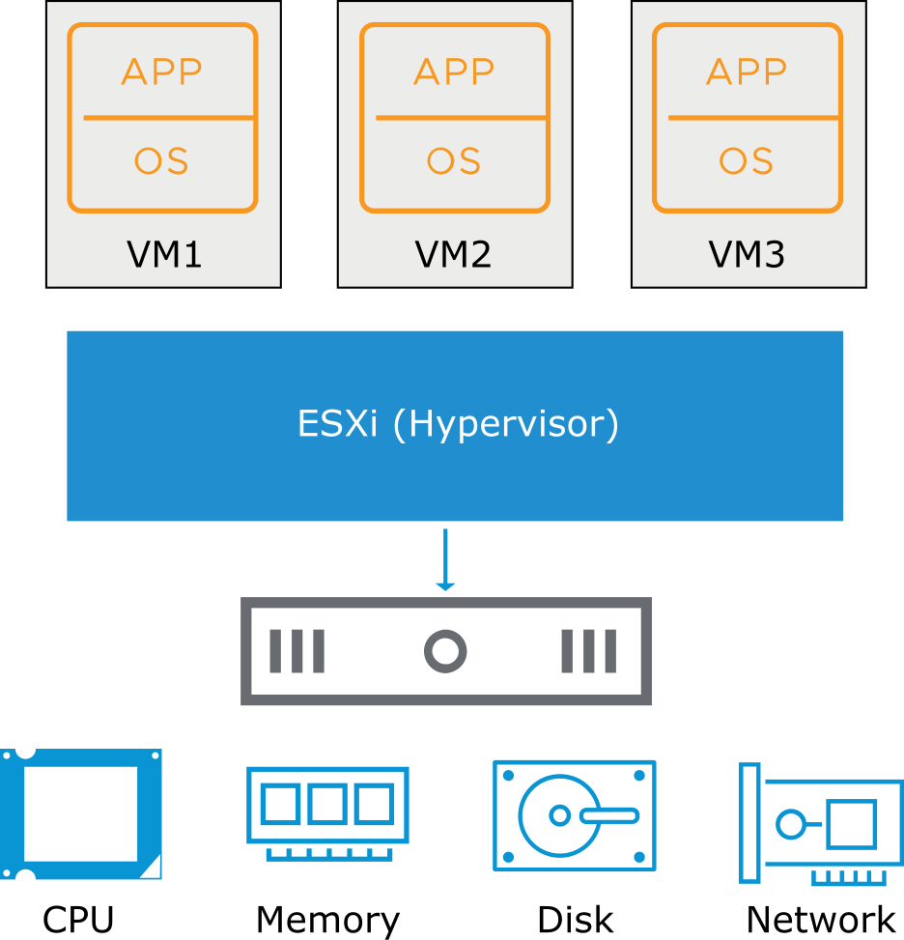
Virtual Machine: Guest and Consumer of ESXi Host
Any application in any supported OS can run in a VM (guest) and consume CPU, memory, disk, and network from host-based resources.
Notes:
A virtual machine is an abstraction in software of a physical machine. A VM turns components into files that act like physical components.
For the list of all supported operating systems, see VMware Compatibility Guide at https://www.vmware.com/resources/compatibility.

Slide 20
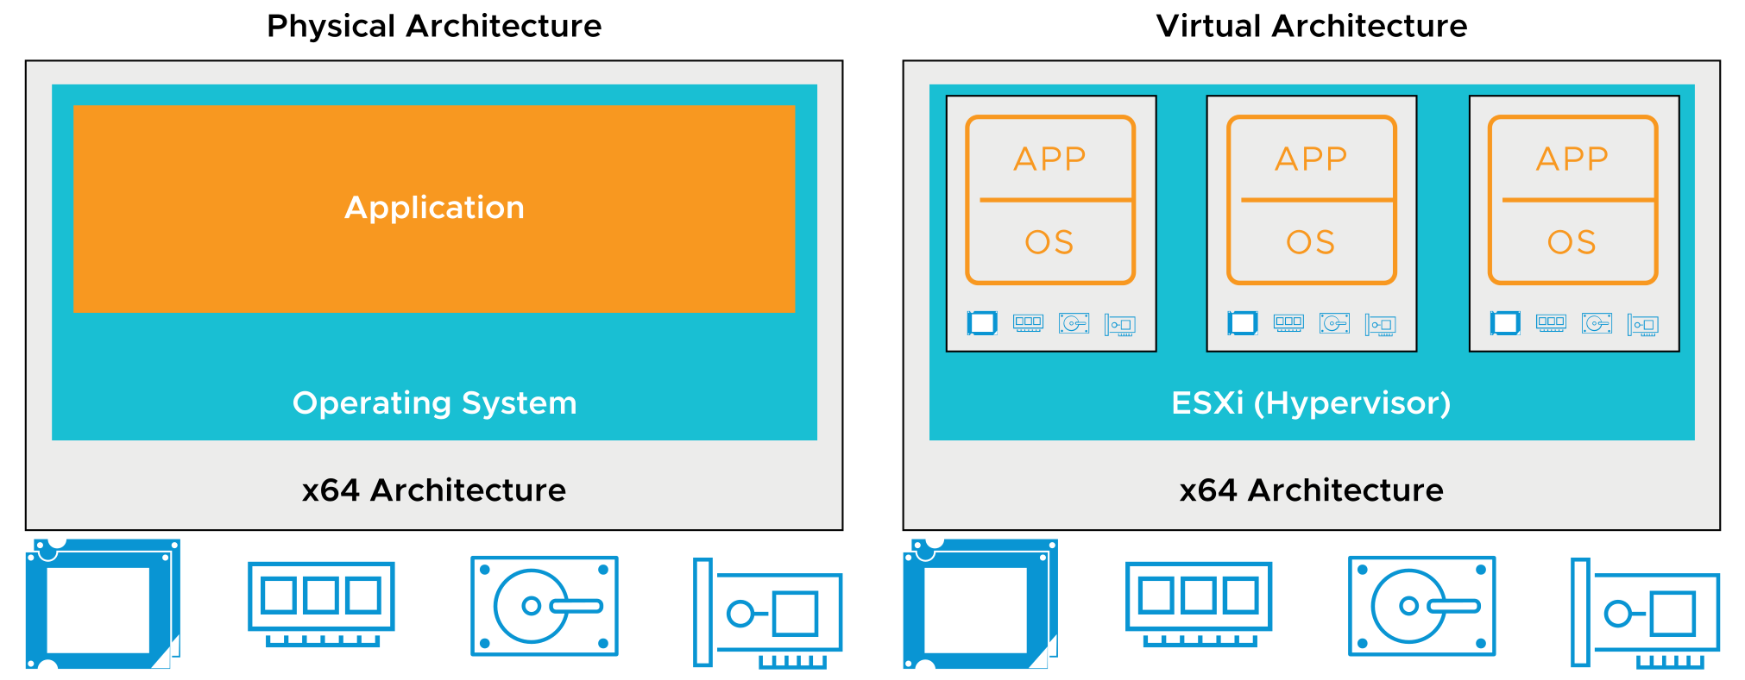
Physical and Virtual Architecture
Virtualization technology abstracts physical components into software components and provides solutions for many IT problems.
Notes:
You can use virtualization to consolidate and run multiple workloads as VMs on a single computer.
The slide shows the differences between a virtualized and a nonvirtualized host. In traditional architectures, the operating system interacts directly with the installed hardware. The operating system schedules processes to run, allocates memory to applications, sends and receives data on network interfaces, and both reads from and writes to attached storage devices. In comparison, a virtualized host interacts with the installed hardware through a thin layer of software called the virtualization layer or hypervisor.
The hypervisor provides physical hardware resources dynamically to VMs as needed to support the operation of the VMs. With the hypervisor, VMs can operate with a degree of independence from the underlying physical hardware. For example, a VM can be moved from one physical host to another. In addition, its virtual disks can be moved from one type of storage to another without affecting the functioning of the VM.

Slide 21
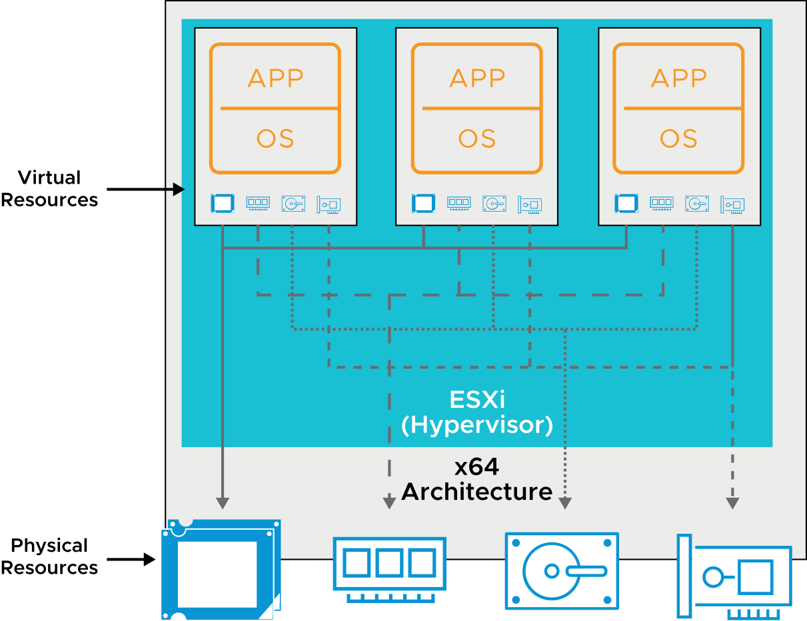
Physical Resource Sharing
Multiple VMs, running on a physical host, share the compute, memory, network, and storage resources of the host.
Notes:
With virtualization, you can run multiple VMs on a single physical host, with each VM sharing the resources of one physical computer across multiple environments. VMs share access to CPUs and are scheduled to run by the hypervisor. In addition, VMs are assigned their own region of memory to use and share access to the physical network cards and disk controllers. Different VMs can run different operating systems and applications on the same physical computer.
When multiple VMs run on an ESXi host, each VM is allocated a portion of the physical resources. The hypervisor schedules VMs like a traditional operating system allocates memory and schedules applications. These VMs run on various CPUs. The ESXi hypervisor can also overcommit memory. Memory is overcommitted when your VMs can use more virtual RAM than the physical RAM that is available on the host
VMs, like applications, use network and disk bandwidth. However, VMs are managed with elaborate control mechanisms to manage how much access is available for each VM. With the default resource allocation settings, all VMs associated with the same ESXi host receive an equal share of available resources.

Slide 22
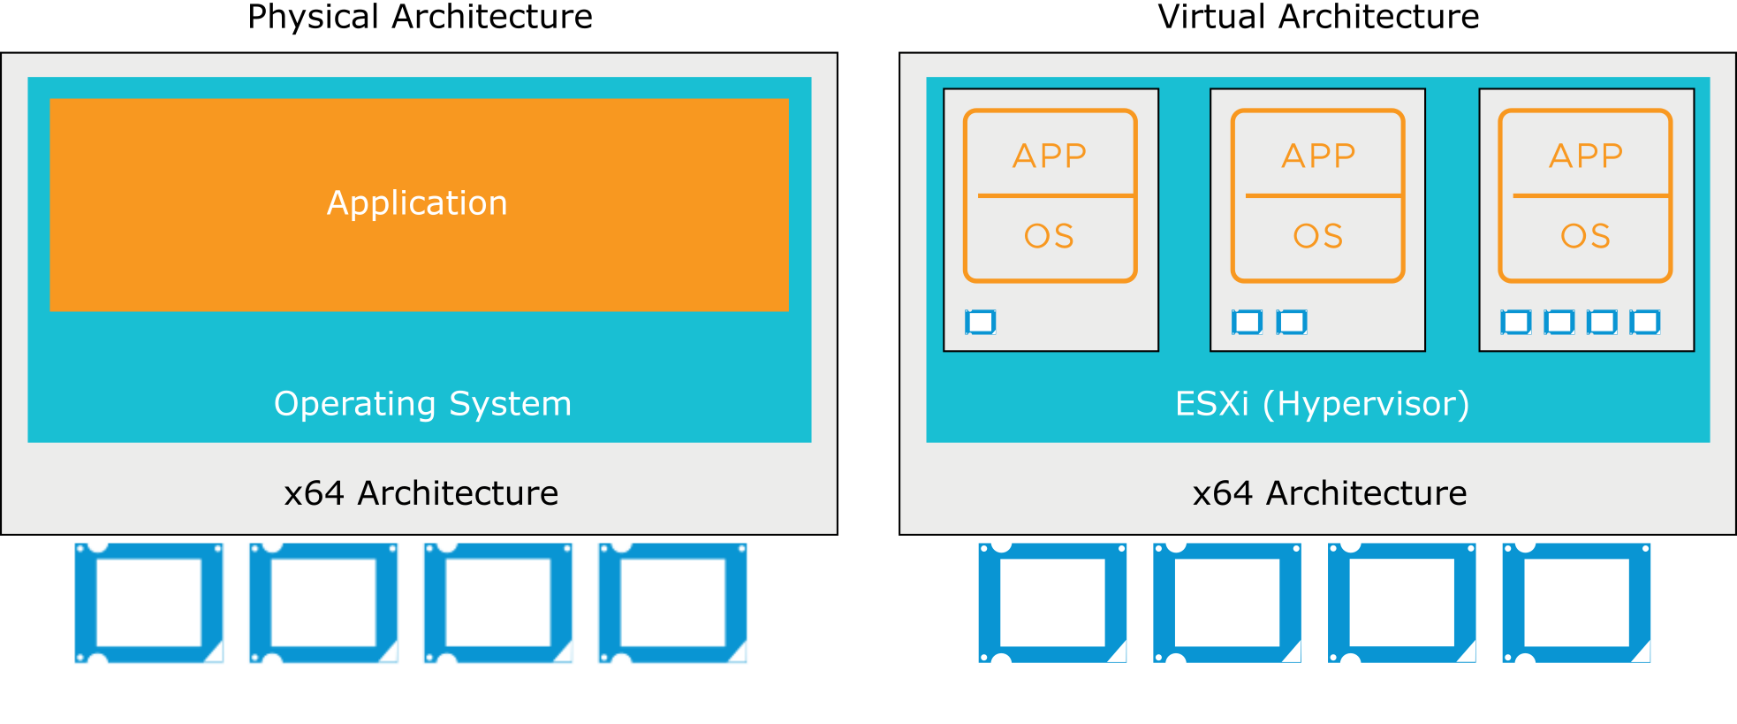
CPU Virtualization
In a physical environment, the operating system assumes the ownership of all the physical CPUs in the system.
CPU virtualization emphasizes performance and runs directly on the available CPUs.
Notes:
The virtualization layer runs instructions only when needed to make VMs operate as if they were running directly on a physical machine. CPU virtualization is not emulation. With a software emulator, programs can run on a computer system other than the one for which they were originally written. Emulation provides portability but might negatively affect performance. CPU virtualization is not emulation because the supported guest operating systems are designed for x64 processors. Using the hypervisor the operating systems can run natively on the hosts’ physical x64 processors.
When many virtual VMs are running on an ESXi host, those VMs might compete for CPU resources. When CPU contention occurs, the ESXi host time slices the physical processors across all virtual machines so that each VM runs as if it had a specified number of virtual processors.

Slide 23
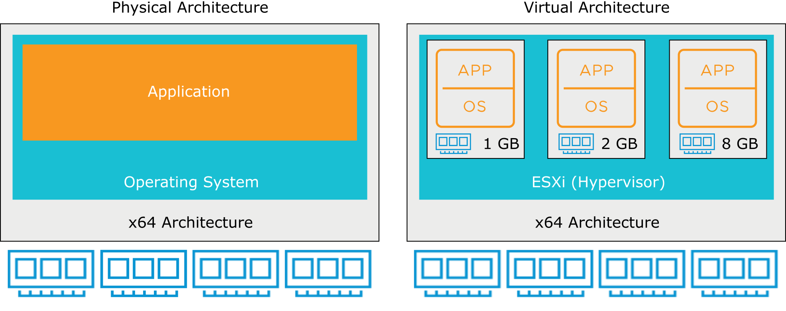
Physical and Virtualized Host Memory Usage
In a physical environment, the operating system assumes the ownership of all physical memory in the system.
Memory virtualization emphasizes performance and runs directly on the available RAM.
Notes:
When an application starts, it uses the interfaces provided by the operating system to allocate or release virtual memory pages during the execution. Virtual memory is a decades-old technique used in most general-purpose operating systems. Operating systems use virtual memory to present more memory to applications than they physically have access to. Almost all modern processors have hardware to support virtual memory.
Virtual memory creates a uniform virtual address space for applications. With the operating system and hardware, virtual memory can handle the address translation between the virtual address space and the physical address space. This technique adapts the execution environment to support large address spaces, process protection, file mapping, and swapping in modern computer systems. In a virtualized environment, the VMware virtualization layer creates a contiguous addressable memory space for the VM when it is started. The allocated memory space is configured when the VM is created and has the same properties as the virtual address space. With this configuration, the hypervisor can run multiple VMs simultaneously while protecting the memory of each VM from being accessed by others.

Slide 24
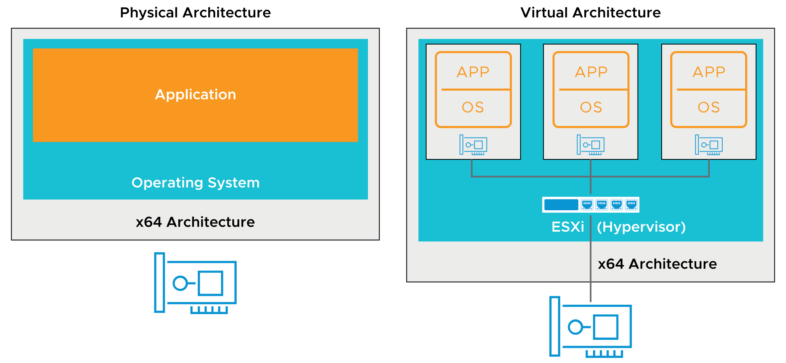
Physical and Virtual Networking
Virtual Ethernet adapters and virtual switches are key virtual networking components.
Notes:
A VM can be configured with one or more virtual Ethernet adapters. VMs use virtual switches on the same ESXi host to communicate with one another by using the same protocols that are used over physical switches, without the need for additional hardware. Virtual switches also support VLANs that are compatible with standard VLAN implementations from other networking equipment vendors. With VMware virtual networking, you can link local VMs together and link local VMs to the external network through a virtual switch.
A virtual switch, like a physical Ethernet switch, forwards frames at the data link layer. An ESXi host might contain multiple virtual switches. The virtual switch connects to the external network through outbound Ethernet adapters, called vmnics. The virtual switch can bind multiple vmnics together, like NIC teaming on a traditional server, offering greater availability and bandwidth to the VMs using the virtual switch.
Virtual switches are similar to modern physical Ethernet switches in many ways. Like a physical switch, each virtual switch is isolated and has its own forwarding table. So every destination that the switch looks up can match only ports on the same virtual switch where the frame originated. This feature improves security, making it difficult for hackers to break virtual switch isolation.
Virtual switches also support VLAN segmentation at the port level, so that each port can be configured as an access or trunk port, providing access to either single or multiple VLANs.
However, unlike physical switches, virtual switches do not require the Spanning Tree Protocol because a single-tier networking topology is enforced. Multiple virtual switches cannot be interconnected, and network traffic cannot flow directly from one virtual switch to another virtual switch on the same host. Virtual switches provide all the ports that you need in one switch. Virtual switches do not need to be cascaded because virtual switches do not share physical Ethernet adapters, and leaks do not occur between virtual switches.

Slide 25
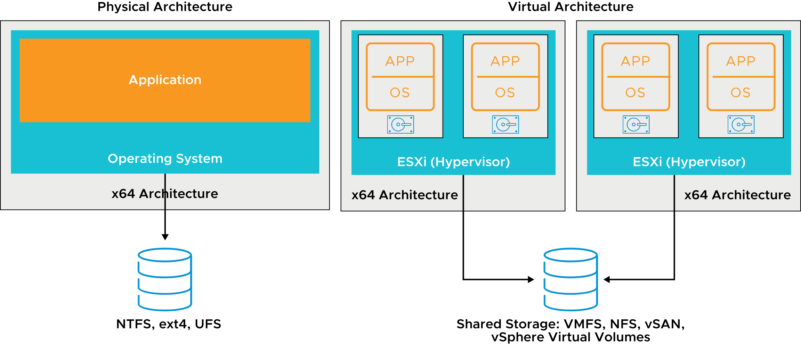
Physical File Systems and Datastores
vSphere VMFS provides a distributed storage architecture, where multiple ESXi hosts can read or write to the shared storage concurrently.
Notes:
To store virtual disks, ESXi uses datastores, which are logical containers that hide the specifics of physical storage from VMs and provide a uniform model for storing VM files. Datastores that you deploy on block storage devices use the VMFS format, a special high-performance file system format that is optimized for storing virtual machines.
VMFS is designed, constructed, and optimized for a virtualized environment. It is a high-performance cluster file system designed for virtual machines. It functions in the following ways:
Uses distributed journaling of its file system metadata changes for fast and resilient recovery if a hardware failure occurs
Increases resource usage by providing multiple VMs with shared access to a consolidated pool of clustered storage
Is the foundation of distributed infrastructure services, such as live migration of VMs and VM files, dynamically balanced workloads across available compute resources, automated restart of VMs, and fault tolerance
VMFS provides an interface to storage resources so that several storage protocols (Fibre Channel, Fibre Channel over Ethernet, and iSCSI) can be used to access datastores on which VMs can reside. With the dynamic growth of VMFS datastores through aggregation of storage resources and dynamic expansion of a VMFS datastore, you can increase a shared storage resource pool with no downtime.
With the distributed locking methods, VMFS forges the link between the VM and the underlying storage resources. VMs can use the unique capabilities of VMFS to join a cluster seamlessly, with no management overhead.

Slide 26
GPU Virtualization
GPU graphics devices optimize complex graphics operations. These operations can run at high performance without overloading the CPU.
Virtual GPUs can be added to VMs for the following use cases:
Rich 2D and 3D graphics
VMware Horizon virtual desktops
Graphics-intensive applications, such as those used by architects and engineers
Server applications for massively parallel tasks, such as scientific computation applications
You can configure VMs with up to four vGPU devices to cover use cases requiring multiple GPU accelerators.
VMware supports AMD and NVIDIA graphics cards.
Notes:
GPUs can be used by developers of server applications. Although servers do not usually have monitors, GPU support is important and relevant to server virtualization.

Slide 27
Review of Learner Objectives
After completing this lesson, you should be able to meet the following objective:
Explain how vSphere interacts with CPUs, memory, networks, and storage

Slide 28
Lesson 3: vSphere User Interfaces

Slide 29
Learner Objectives
After completing this lesson, you should be able to meet the following objective:
Recognize the user interfaces for accessing the vCenter Server system and ESXi hosts

Slide 30
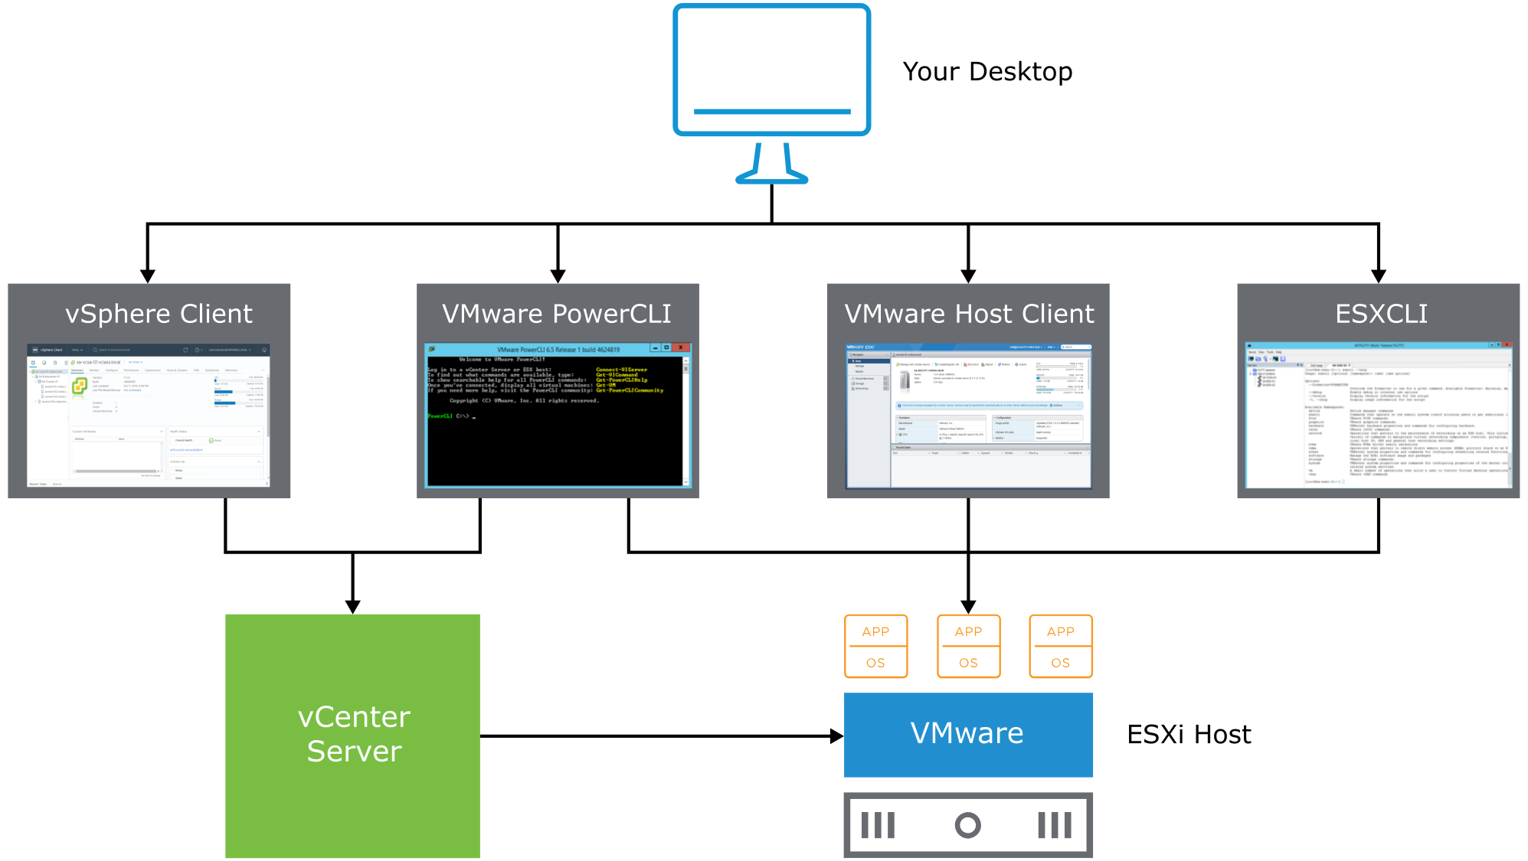
vSphere User Interfaces
You can use the vSphere Client, PowerCLI, VMware Host Client, and ESXCLI to interact with the vSphere environment.
For information on ports and protocols, see http://ports.vmware.com.
Notes:
VMware Host Client provides direct management of individual ESXi hosts. VMware Host Client is generally used only when management through vCenter Server is not possible.
With the vSphere Client, an HTML5-based client, you can manage vCenter Server Appliance and the vCenter Server object inventory.
VMware Host Client and the vSphere Client provide the following benefits:
Clean, modern UI
No browser plug-ins to install or manage
Integrated into vCenter Server and ESXi

Slide 31
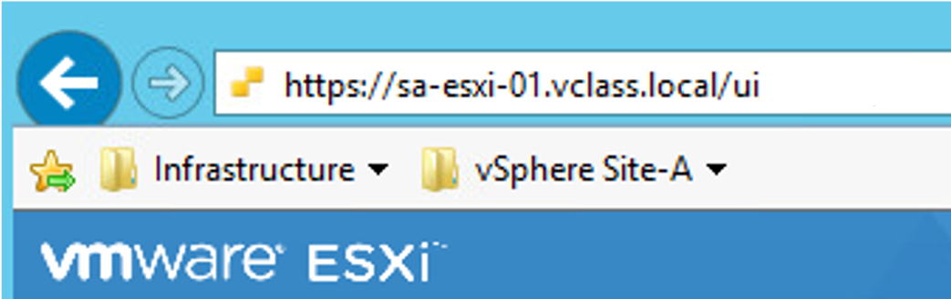
About VMware Host Client
VMware Host Client is an HTML5-based user interface that you can use to manage individual ESXi hosts directly when vCenter Server is unavailable.
VMware Host Client is served from ESXi, and you access it from a supported browser at https://ESXi_FQDN_or_IP_Address/ui.
Notes:
VMware ESXi in the upper-left corner of the banner on the VMware Host Client interface helps you to differentiate VMware Host Client from other clients.

Slide 32
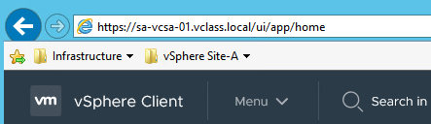
About vSphere Client
The vSphere Client is an HTML5-based client. You manage the vSphere environment with the vSphere Client by connecting to vCenter Server Appliance.
You access the vSphere Client from a supported browser at https://vCenter_Server_Appliance_FQDN_or_IP_Address/ui.
Notes:
vSphere Client, which in the upper-left corner of the banner on the vSphere Client interface, helps you differentiate vSphere Client from other clients.
When you use https://vCenter_Server_Appliance_FQDN_or_IP_Address/ui to access the vSphere Client, the URL internally redirects to port 9443 on your vCenter Server system.
With the vSphere Client, you can manage vCenter Server Appliance through a web browser, and Adobe Flex does not have to be enabled in the browser.

Slide 33
About PowerCLI and ESXCLI
PowerCLI is a command-line and scripting tool that is built on Windows PowerShell:
Provides a PowerShell interface to vSphere API
Provides more than 700 cmdlets for managing and automating vSphere
The ESXCLI tool allows for remote management of ESXi hosts by using the ESXCLI command set:
ESXCLI can be downloaded from the VMware {code} page at https://code.vmware.com/web/tool/7.0/esxcli.
ESXCLI commands can be run against a vCenter Server system and target any ESXi system.
Notes:
You can install ESXCLI on a Windows or Linux system. You can run ESXCLI commands from the Windows or Linux system to manage ESXi systems.
For more information about ESXCLI, see https://code.vmware.com/web/tool/7.0/esxcli.
For more information about PowerCLI, see https://code.vmware.com/web/tool/12.0.0/vmware-powercli.

Slide 34
Lab 1: Accessing the Lab Environment
Log in to the student desktop and access the vSphere Client and VMware Host Client:
Access the Student Desktop
Log In to an ESXi Host with VMware Host Client
Log In to vCenter Server with the vSphere Client

Slide 35
Review of Learner Objectives
After completing this lesson, you should be able to meet the following objective:
Recognize the user interfaces for accessing the vCenter Server system and ESXi hosts

Slide 36
Lesson 4: Overview of ESXi

Slide 37
Learner Objectives
After completing this lesson, you should be able to meet the following objectives:
Describe the ESXi host architecture
Navigate the Direct Console User Interface (DCUI) to configure an ESXi host
Recognize user account best practices
Install an ESXi host
Configure ESXi host settings

Slide 38
About ESXi
ESXi is a hypervisor that you can buy with vSphere or get in a free, downloadable version. ESXi has the following features:
High security:
Host-based firewall
Memory hardening
Kernel module integrity
Trusted Platform Module (TPM 2.0)
UEFI secure boot
Encrypted core dumps
Small disk footprint
Quick boot for faster patching and upgrades
Installable on hard disks, SAN LUNs, SSD, USB devices, SD cards, SATADOM, and diskless hosts
Notes:
To ensure that your physical servers are supported by ESXi 7.0, check VMware Compatibility Guide at https://www.vmware.com/resources/compatibility.
You can obtain a free version of ESXi, called vSphere Hypervisor, or you can purchase a licensed version with vSphere. ESXi can be installed on a hard disk, a USB device, or an SD card. ESXi can also be installed on diskless hosts (directly into memory) with vSphere Auto Deploy.
ESXi has a small disk footprint for added security and reliability. ESXi provides additional protection with the following features:
Host-based firewall: To minimize the risk of an attack through the management interface, ESXi includes a firewall between the management interface and the network.
Memory hardening: The ESXi kernel, user-mode applications, and executable components, such as drivers and libraries, are located at random, nonpredictable memory addresses. Combined with the nonexecutable memory protections made available by microprocessors, memory hardening provides protection that makes it difficult for malicious code to use memory exploits to take advantage of vulnerabilities.
Kernel module integrity: Digital signing ensures the integrity and authenticity of modules, drivers, and applications as they are loaded by the VMkernel.
Trusted Platform Module: TPM is a hardware element that creates a trusted platform. This element affirms that the boot process and all drivers loaded are genuine.
UEFI secure boot: This feature is for systems that support UEFI secure boot firmware, which contains a digital certificate that the VMware infrastructure bundles (VIBs) chain to. At boot time, a verifier is started before other processes to check the VIB’s chain to the certificate in the firmware.
Lockdown modes: This vSphere feature disables login and API functions from being executed directly on an ESXi host.
ESXi Quick Boot: With this feature, ESXi can reboot without reinitializing the physical server BIOS. Quick Boot reduces remediation time during host patch or host upgrade operations. Quick Boot is enabled by default on supported hardware.

Slide 39
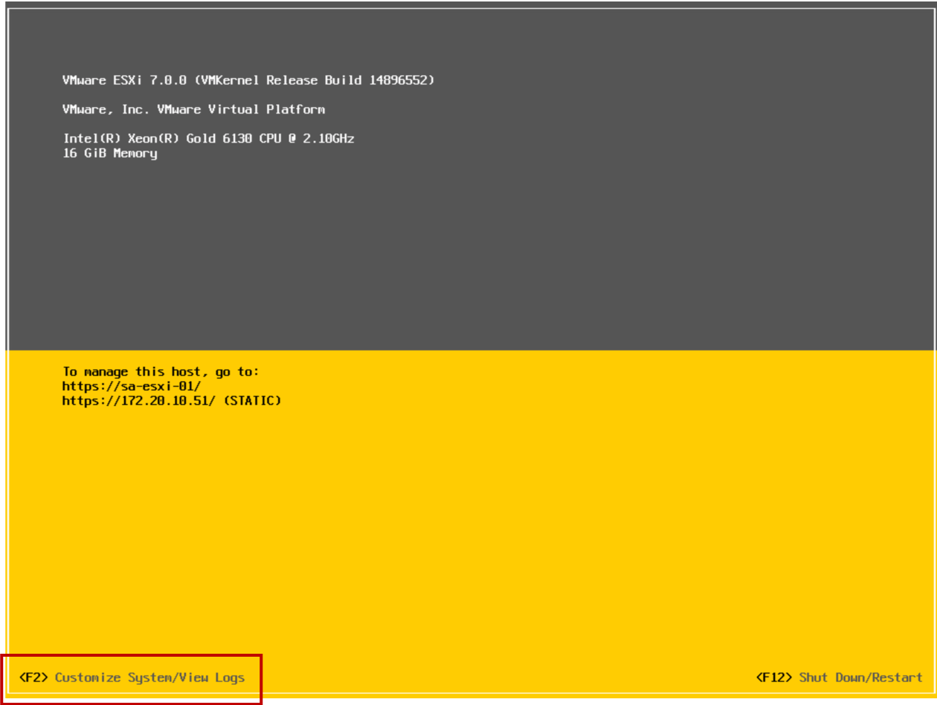
Configuring an ESXi Host
The DCUI is a text-based user interface with keyboard-only interaction.
Notes:
You use the Direct Console User Interface (DCUI) to configure certain settings for ESXi hosts. The DCUI is a low-level configuration and management interface, accessible through the console of the server, that is used primarily for initial basic configuration. You press F2 to start customizing system settings.

Slide 40
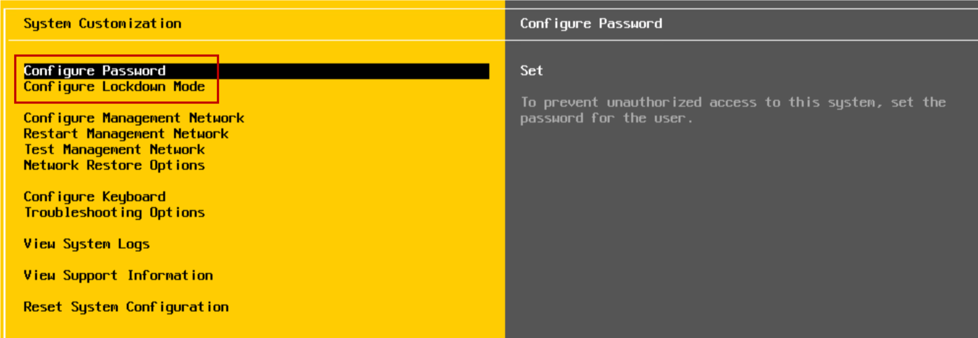
Configuring an ESXi Host: Root Access
Administrators use the DCUI to configure root access settings:
Set a root password (complex passwords only).
Enable or disable lockdown mode:
Limits management of the host to vCenter Server
Can be configured only for hosts managed by a vCenter Server instance
Notes:
The administrative user name for the ESXi host is root. The root password must be configured during the ESXi installation process.

Slide 41
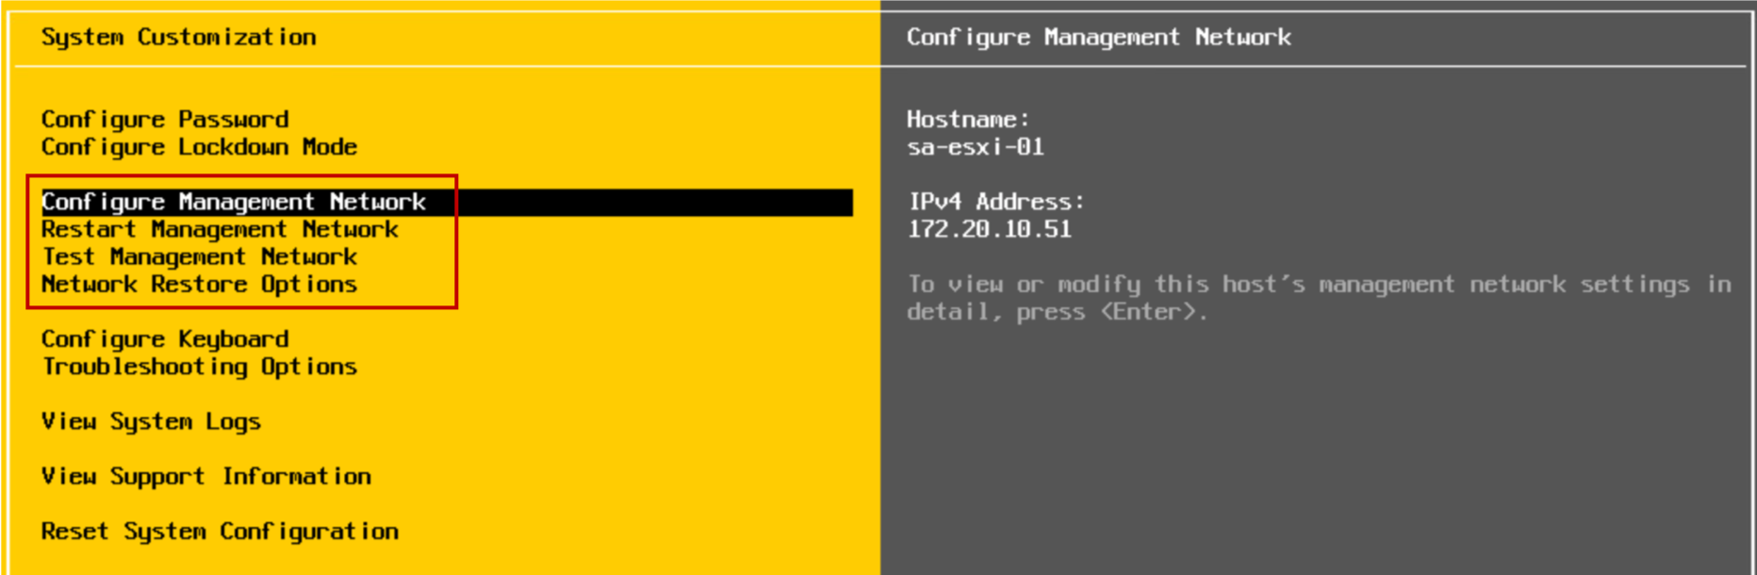
Configuring an ESXi Host: Management Network
Using the DCUI, you can modify network settings:
Host name
IP configuration (IP address, subnet mask, default gateway)
DNS servers
Notes:
You must set up your IP address before your ESXi host is operational. By default, a DHCP-assigned address is configured for the ESXi host. To change or configure basic network settings, you use the DCUI.
In addition to changing IP settings, you perform the following tasks from the DCUI:
Configure VLAN settings.
Configure IPv6 addressing.
Set custom DNS suffixes.
Restart the management network (without rebooting the system).
Test the management network (using ping and DNS requests).
Disable a management network.

Slide 42
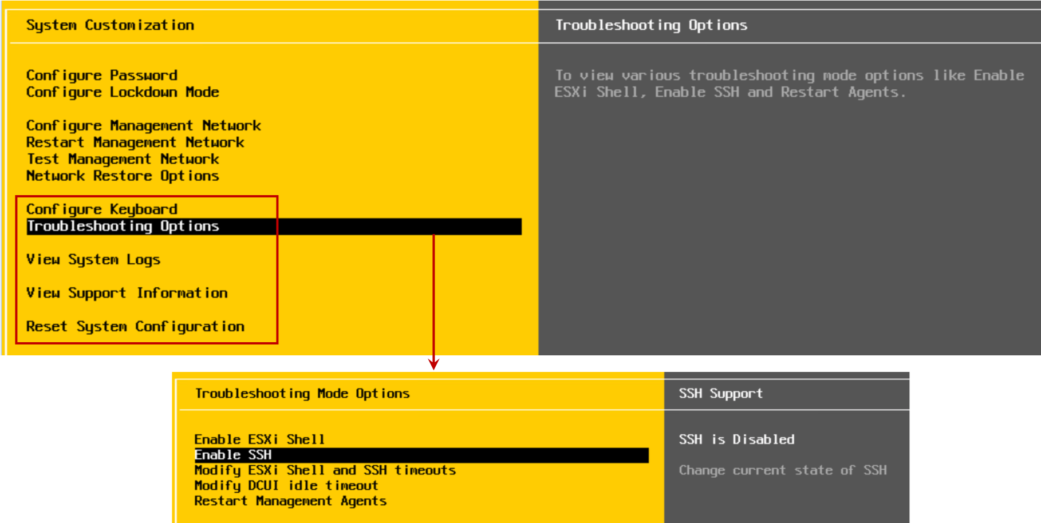
Configuring an ESXi Host: Other Settings
Using the DCUI, you can configure the keyboard layout, enable troubleshooting services, view support information, and view system logs.
Notes:
From the DCUI, you can change the keyboard layout, view support information, such as the host’s license serial number, and view system logs. The default keyboard layout is U.S. English.
You can use the troubleshooting options, which are disabled by default, to enable or disable troubleshooting services:
vSphere ESXi Shell: For troubleshooting issues locally
SSH: For troubleshooting issues remotely by using an SSH client, for example, PuTTY
The best practice is to keep troubleshooting services disabled until they are necessary, for example, when you are working with VMware technical support to resolve a problem.
By selecting the Reset System Configuration option, you can reset the system configuration to its software defaults and remove custom extensions or packages that you added to the host.

Slide 43
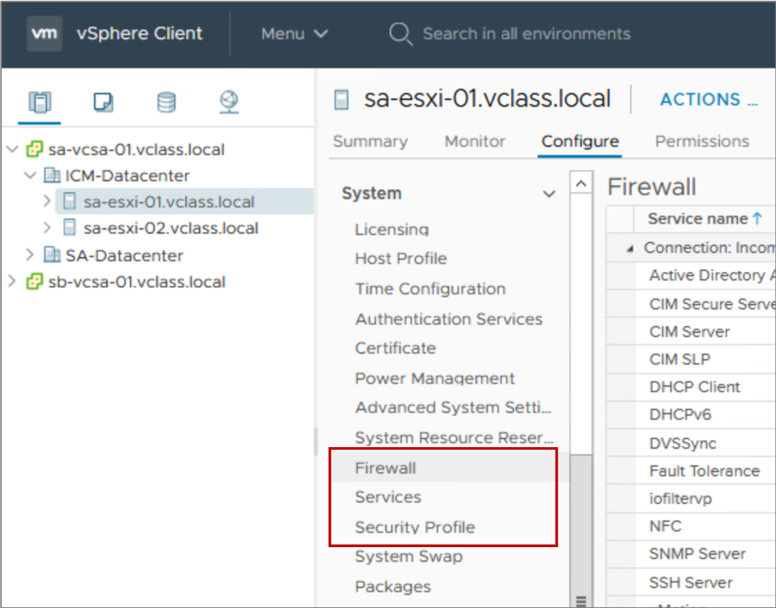
Controlling Remote Access to an ESXi Host
You can use the vSphere Client to customize essential security settings that control remote access to an ESXi host:
The ESXi firewall is enabled by default:
The firewall blocks incoming and outgoing traffic, except for the traffic that is enabled in the host’s firewall settings.
Services, such as the NTP client and the SSH client, can be managed by the administrator.
Lockdown mode prevents remote users from logging in to the host directly. The host is accessible only through the DCUI or vCenter Server.
Notes:
An ESXi host includes a firewall as part of the default installation. On ESXi hosts, remote clients are typically prevented from accessing services on the host. Similarly, local clients are typically prevented from accessing services on remote hosts. To ensure the integrity of the host, few ports are open by default. To provide or prevent access to certain services or clients, you must modify the properties of the firewall.
You can configure firewall settings for incoming and outgoing connections for a service or a management agent. For some services, you can manage service details. For example, you can use the Start, Stop, or Restart buttons to change the status of a service temporarily. Alternatively, you can change the startup policy so that the service starts with the host or with port use. For some services, you can explicitly specify IP addresses from which connections are allowed.

Slide 44
Managing User Accounts: Best Practices
When assigning user accounts to access ESXi hosts or vCenter Server systems, ensure that you follow these security guidelines:
Strictly control root privileges to ESXi hosts.
Create strong root account passwords that have at least eight characters. Use special characters, case changes, and numbers. Change passwords periodically.
Manage ESXi hosts centrally through the vCenter Server system by using the appropriate vSphere client.
Minimize the use of local users on ESXi hosts:
Add the ESXi hosts to Active Directory and add the relevant administrator users to the ESX Admins domain group. Users in the ESX Admins domain group have root privileges on ESXi hosts, by default.
If local users are created, manage them centrally using the esxcli command in the vSphere CLI.
Notes:
On an ESXi host, the root user account is the most powerful user account on the system. The user root can access all files and all commands. Securing this account is the most important step that you can take to secure an ESXi host.
Whenever possible, use the vSphere Client to log in to the vCenter Server system and manage your ESXi hosts. In some unusual circumstances, for example, when the vCenter Server system is down, you use VMware Host Client to connect directly to the ESXi host. Although you can log in to your ESXi host through the vSphere CLI or through vSphere ESXi Shell, these access methods should be reserved for troubleshooting or configuration that cannot be accomplished by using VMware Host Client. If a host must be managed directly, avoid creating local users on the host. If possible, join the host to a Windows domain and log in with domain credentials instead.

Slide 45
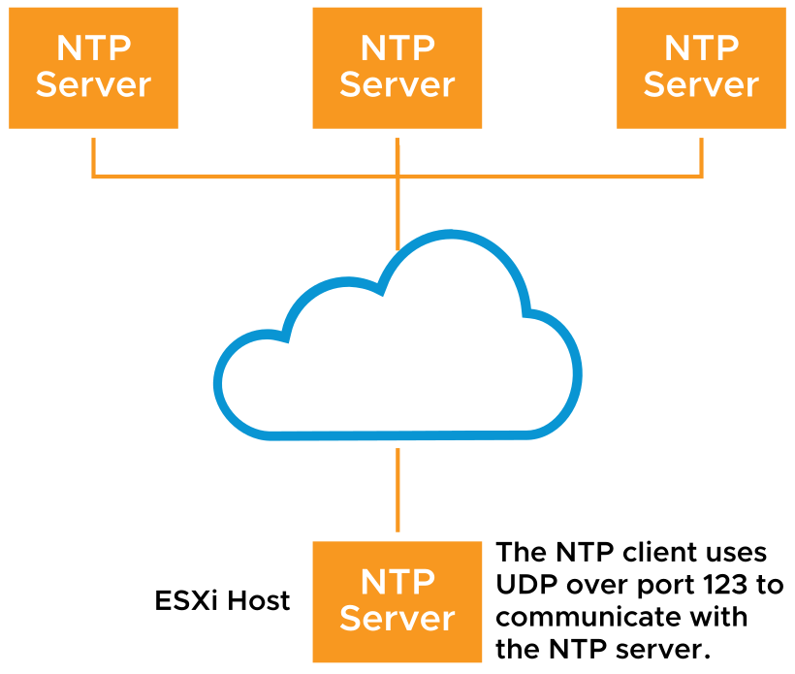
ESXi Host as an NTP Client
Network Time Protocol (NTP) is a client-server protocol used to synchronize a computer’s clock to a time reference.
NTP is important:
For accurate performance graphs
For accurate time stamps in log messages
So that virtual machines have a source to synchronize with
An ESXi host can be configured as an NTP client. It can synchronize time with an NTP server on the Internet or your corporate NTP server.
Notes:
Network Time Protocol (NTP) is an Internet standard protocol that is used to synchronize computer clock times in a network. The benefits of synchronizing an ESXi host’s time include:
Performance data can be displayed and interpreted properly.
Accurate time stamps appear in log messages, which make audit logs meaningful.
VMs can synchronize their time with the ESXi host. Time synchronization is beneficial to applications, such as database applications, running on VMs.
NTP is a client-server protocol. When you configure the ESXi host to be an NTP client, the host synchronizes its time with an NTP server, which can be a server on the Internet or your corporate NTP server.
For information about NTP, see http://www.ntp.org.
For more information about timekeeping, see VMware knowledge base article 1318 at http://kb.vmware.com/kb/1318.

Slide 46
Demonstration: Installing and Configuring ESXi Hosts
Your instructor will run a demonstration.

Slide 47
Lab 2: Configuring an ESXi Host
Use VMware Host Client to configure an ESXi host:
Add an ESXi Host to Active Directory
Log In to the ESXi Host as an Active Directory User
Enable the SSH and vSphere ESXi Shell Services

Slide 48
Review of Learner Objectives
After completing this lesson, you should be able to meet the following objectives:
Describe the ESXi host architecture
Navigate the Direct Console User Interface (DCUI) to configure an ESXi host
Recognize user account best practices
Install an ESXi host
Configure ESXi host settings

Slide 49
Virtual Beans: Data Center
As a Virtual Beans administrator, you now understand essential vSphere terminology. Your initial takeaways about vSphere are as follows:
vSphere is the starting point for building a software-defined data center.
ESXi hosts are highly secure platforms on which Virtual Beans applications run.
Check the VMware Compatibility Guide to ensure that your physical servers support ESXi 7.0.

Slide 50
Key Points
Virtual machines are hardware independent.
VMs share the physical resources of the ESXi host on which they reside.
vSphere abstracts CPU, memory, storage, and networking for VM use.
The ESXi hypervisor runs directly on the host.
Questions?

